Slide 1


WATER VERIFICATION MACHINE
Verifying the water purification level

Slide 2
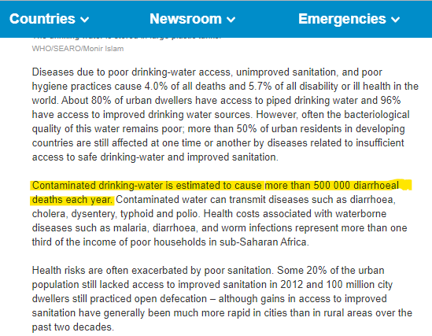
INTRODUCTION
We recently saw this report.
Being part of Atal Tinkering Lab at Delhi Public School, we discussed our idea with our mentors.
We decided that this problem could be solved using replicable and indigenous technology.
SOURCE :WORLD HEALTH ORGANIZATION

Slide 3
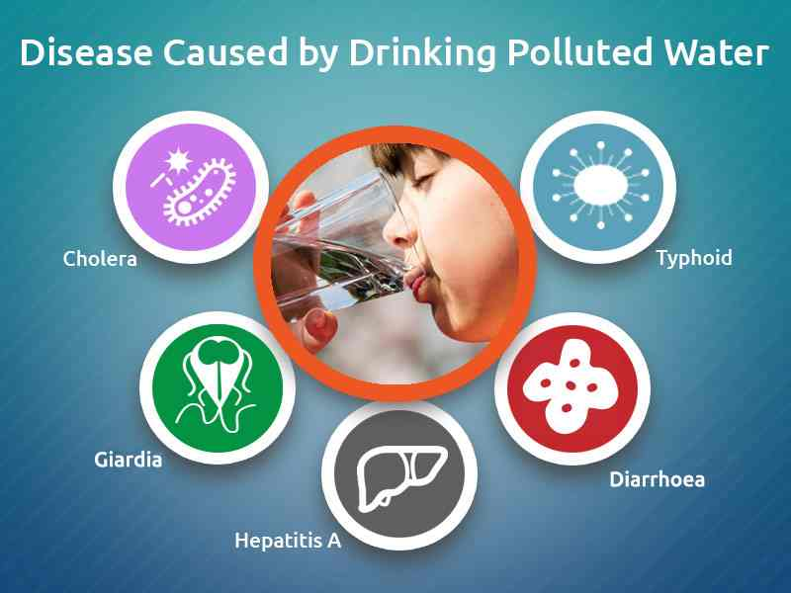
PROBLEM STATEMENT CURRENT METHODS
The problem we seek is that many people drink contaminated water unknowingly. They are not able to check whether the water is suitable for drinking (pure or not) on their own at their homes in a very easy and economical way.
This leads to people suffering from various kinds of diseases due to consumption of contaminated water like cholera, typhoid, diarrhoea, dysentery etc.
Water testing labs are available to verify the water purity at the source. But such labs are in a limited number.
Water should also be verified on the go at the distribution point (taps, showers, faucets etc.) for which a small device is needed.

Slide 4
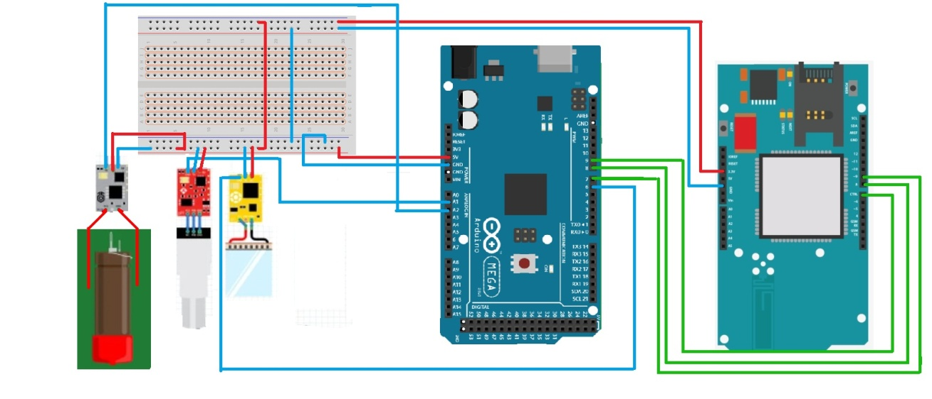
OUR SOLUTION
CIRCUIT DIAGRAM
We propose to create a Water Verification Machine, a small and a handy device that checks the Water purity at the distribution point (taps, showers, Faucets etc.) at individual houses.
ARDUINO CODE

Slide 5
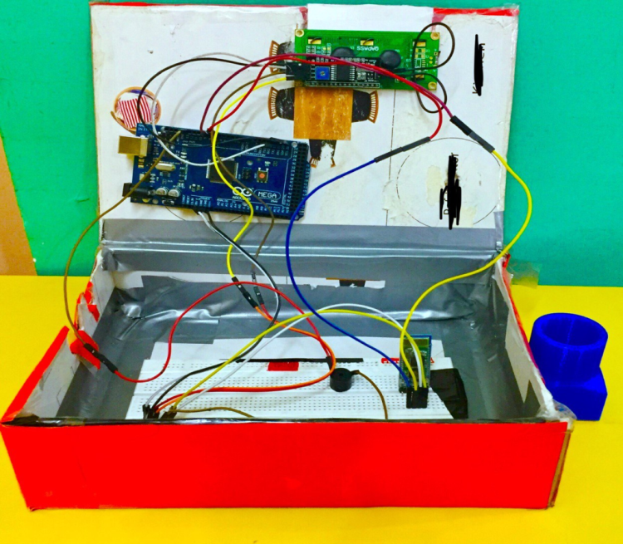
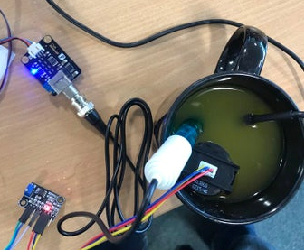
MATERIALS REQUIRED
PROJECT IMAGE (of the PROTOTYPE)
Arduino Mega Board or UNO
Arduino SIM 800L
pH Sensor
Turbidity Sensor
DS1820 Waterproof Temperature Sensor
(16*2) LCD Display
4 RGB LED
Buzzer
Breadboard
Jumper Wires
APPEARANCE
WORKING

Slide 6

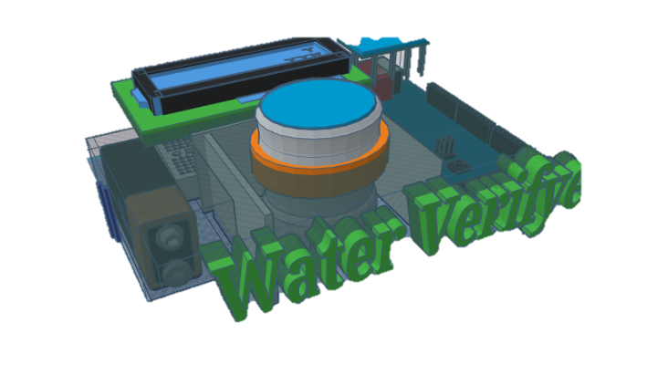
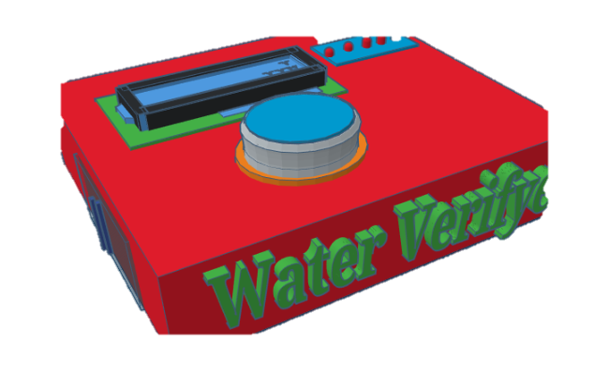
3-D Design
OUTSIDE VIEW / USER VIEW
INSIDE VIEW

Slide 7
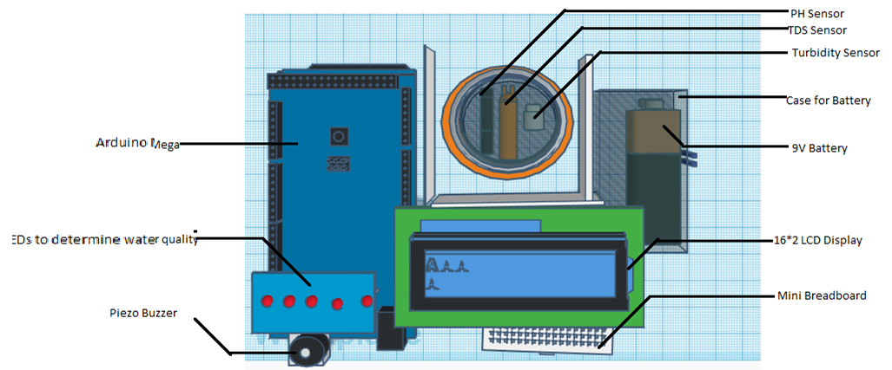
LABELLING

Slide 8
BENEFITS OF OUR SOLUTION (MACHINE)
DETAILED OUTPUTS (COMPLETE ANALYSIS)
The machine will give detailed output as if the water is: Contaminated, Impure, Average, Consumable or the Cleanest.
ACCURATE RESULTS
The machine will be made using the latest technology so, we can assure you about the accurate results.
CONVINIENT TO USE
The machine would be very easy and convenient to use because of its unique shape and size.
ECONOMICAL
One of the important plus-points is that the machine would be economical so that it fits in the budget of the poor and middle-class families.
IMPLEMENTATION & SCOPE IN INDIA
A lot of people, especially in India, face diarrhoeal diseases, like Typhoid and Cholera, due to drinking contaminated water unknowingly.
So, this project has great scope and can be easily implemented in India as it is in great need all over the nation.

Slide 9
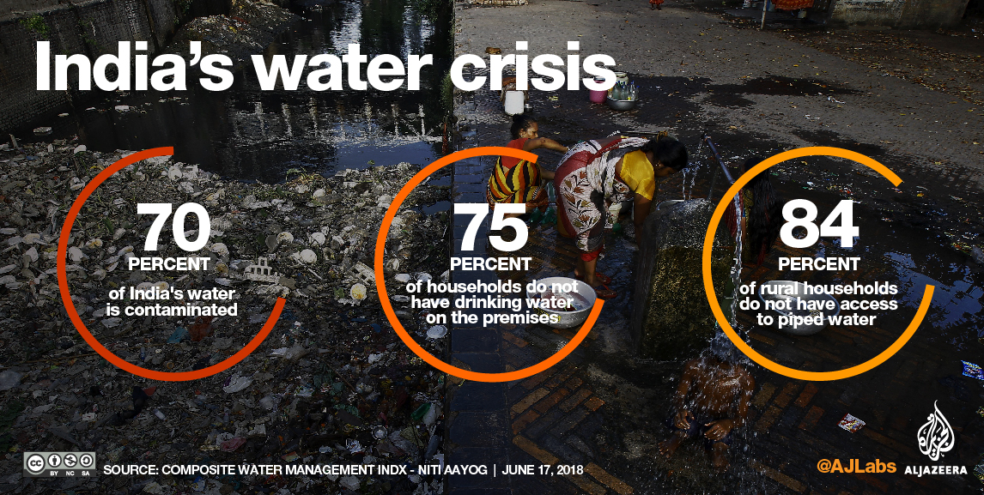
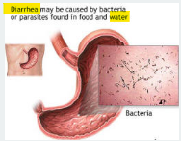
PURPOSE
We’re solving this problem for:
The households in metro-Politian cities and the cities known for bad water quality.
The people who face diarrheal diseases so that they can verify the purity of the water they drink.
SOURCE :ALJAZEERA

Slide 10
RESOURCES
We have taken mentorship from our teachers and used the components from the Atal Tinkering Lab.
To built a life size implementation further, we would require assistance from MINISTRY OF HOUSING AND URBAN DEVELOPMENT and some further components like the PH sensor, Turbidity sensor, etc.
We estimate that the development cost of this life size prototype will be around 40 to 60 thousand rupees.

Slide 11
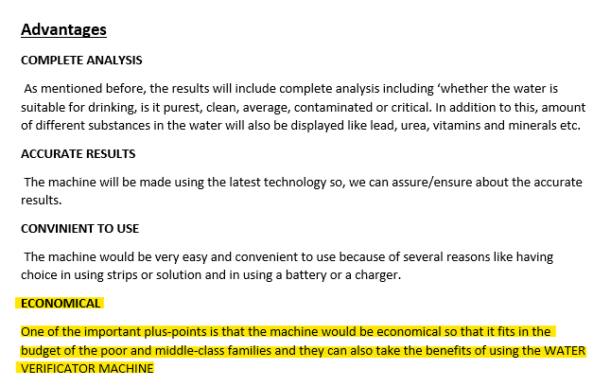
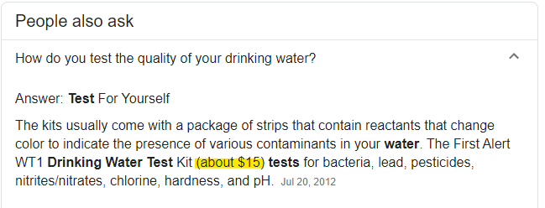
ECONOMIC VIABILITY
OUR PROJECT
CURRENT SITUATION
The current expense born by the citizens of water related sickness is about INR 457.65 per episode.
Our device will cost approximately about 2,000 to 3,200 rupees.

Slide 12
WHY ARE WE BEST SUITED TO OFFER THIS SOLUTION?
We have already implemented prototype with the help of mentorship from industry expert by getting the materials from Atal Tinkering Lab.
We are in the process of taking feedbacks and improving our prototype.
We would appreciate financial assistance and recognition from the ATL Marathon team.

Slide 13
THANK YOU !

